Slide 1
AI Deployment
Full stack application
with integration AI capabilities
Class: DSAI-COHORT1-PT
By: Lua Ai Lian (Irene)
Date: 25 May 2025

Slide 2
Q1. How does the integration of AI models into full stack applications enhance user experience and functionality?
Integrating AI models into full-stack applications enhances user experience through real-time insights, personalized interactions, and automated decision-making. These intelligent features streamline workflows, minimize manual errors, and enable fast, context-aware responses—boosting both usability and operational efficiency across complex, multi-functional platforms.

Slide 3
Q2. What are the key challenges in deploying AI solutions to production, and how can they be addressed in a full stack environment?
AI deployment challenges include model latency, API reliability, and integrating outputs with the user interface. These can be addressed by using lightweight frameworks like Flask, leveraging secure storage (e.g., Excel or MetaMask), and deploying via platforms like Render—ensuring responsive AI interactions without relying on complex infrastructure.

Slide 4
Q3. How do different components of a full stack application (frontend, backend, database, deployment) work together to support AI-driven features?
The frontend captures user input and displays AI-generated results. The backend manages request handling, integrates AI models or APIs, and executes core logic. The database stores inputs and outputs (e.g., Excel, MetaMask). Deployment platforms like Render ensure smooth operation, scalability, and continuous availability of the AI-powered application.

Slide 5
Web application User Interface Overview

Slide 6
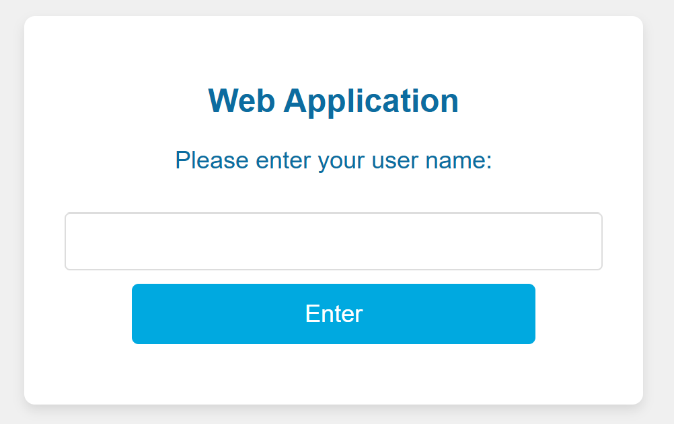
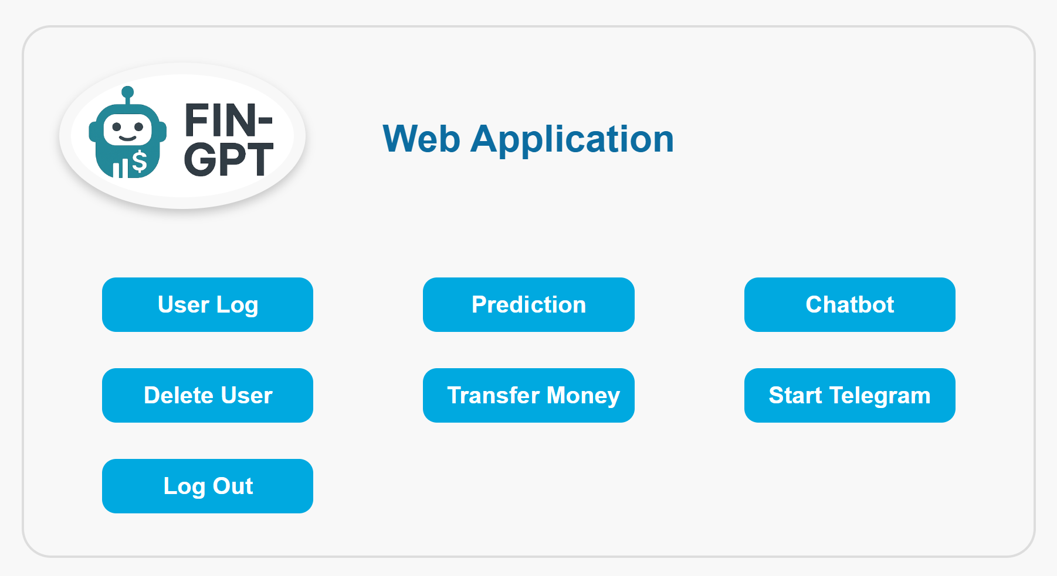
Fin-GPT web applications

Slide 7
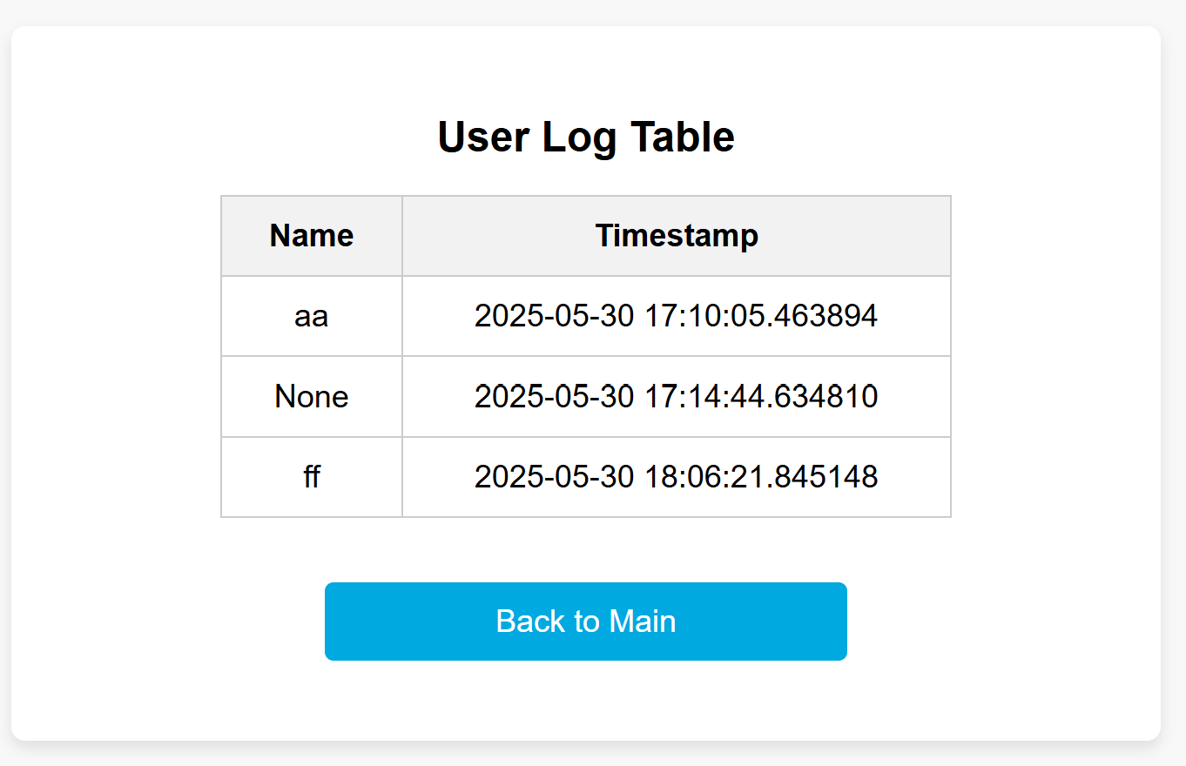
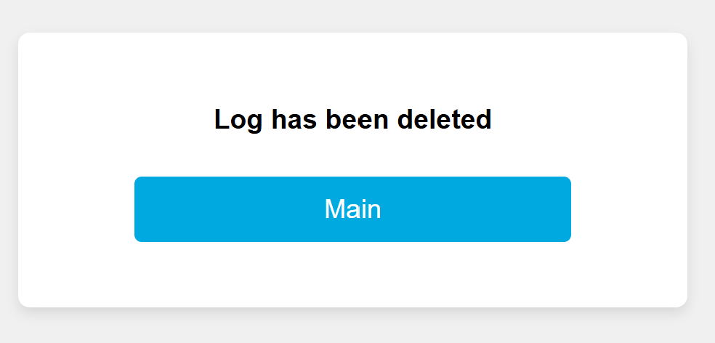
User Log and Log Delete

Slide 8
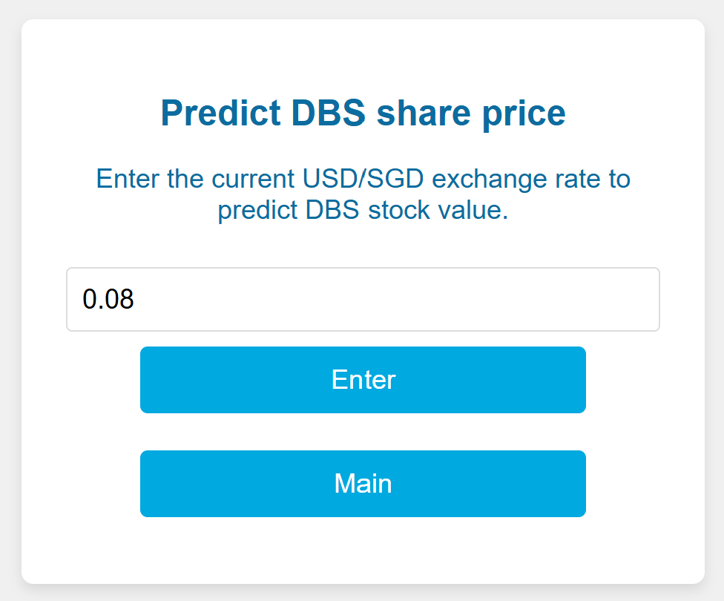
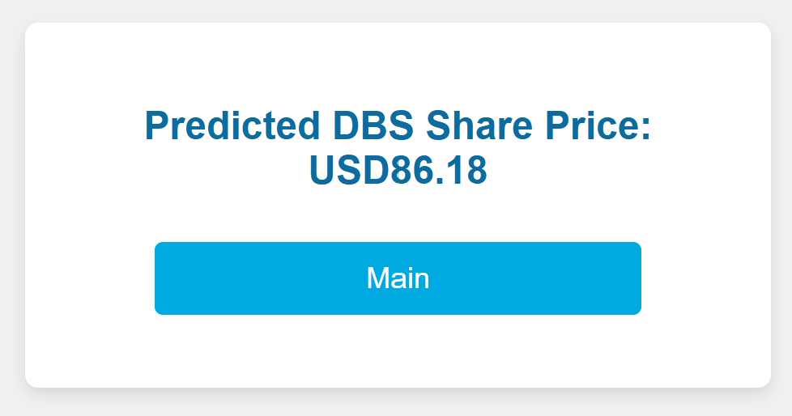
Predict DBS Share Price

Slide 9
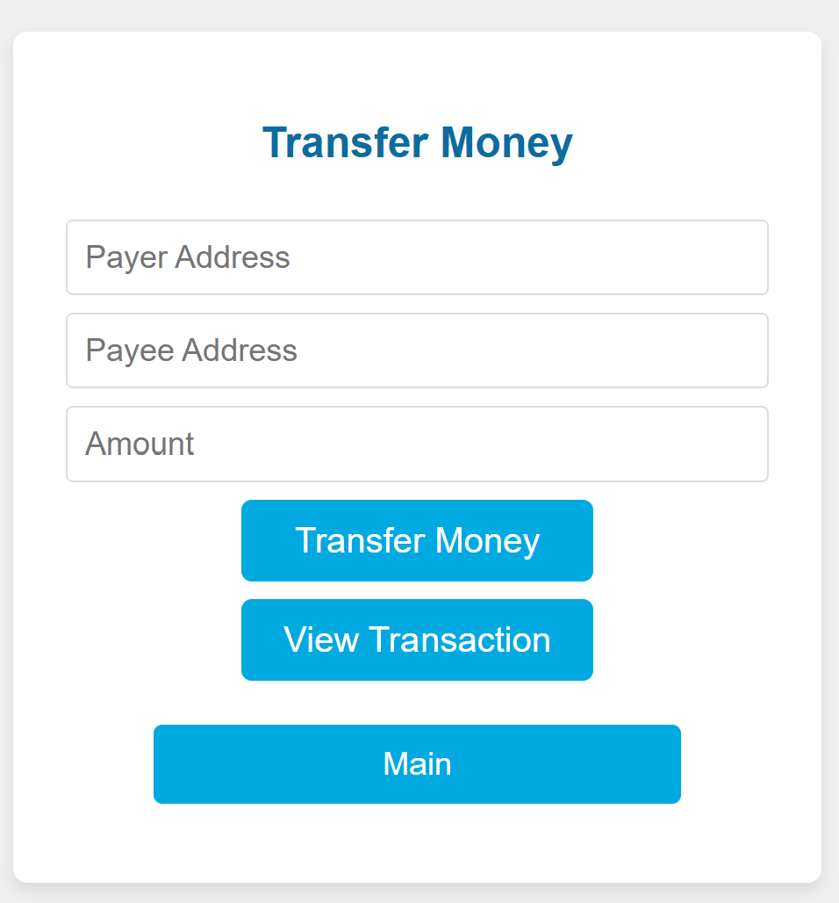
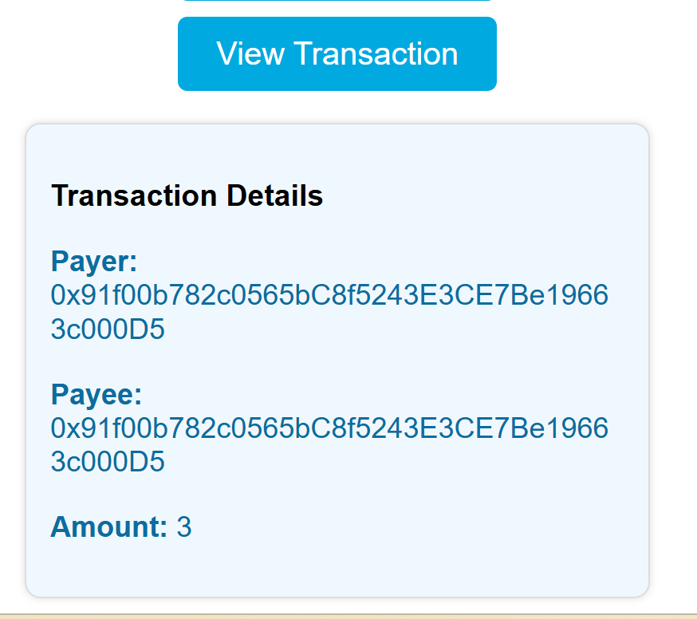
Money Transfer

Slide 10
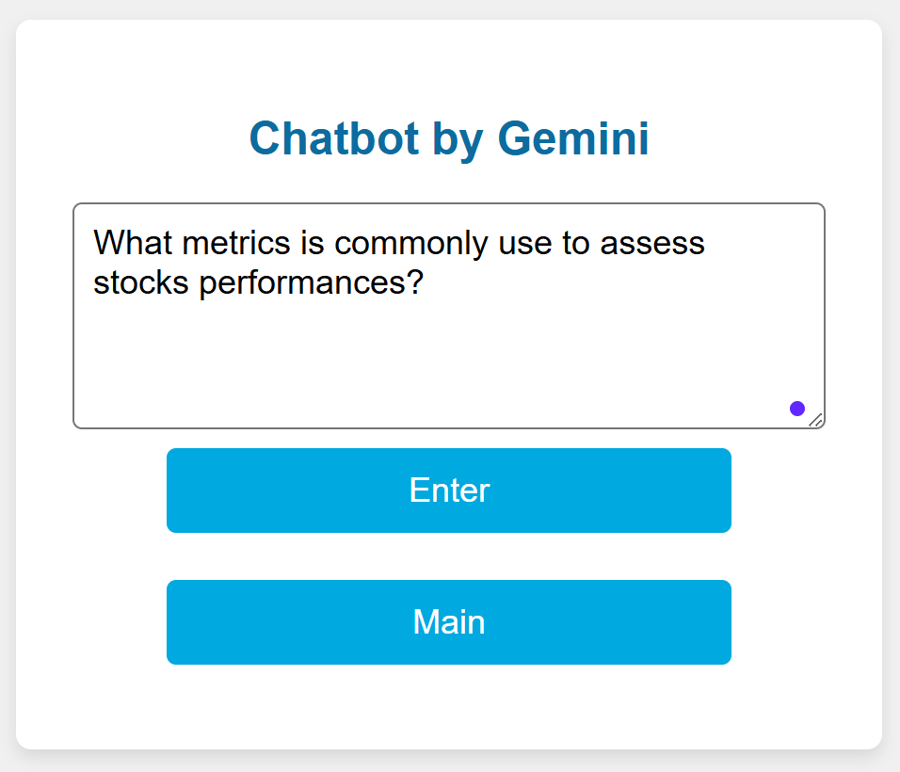

Chatbot

Slide 11
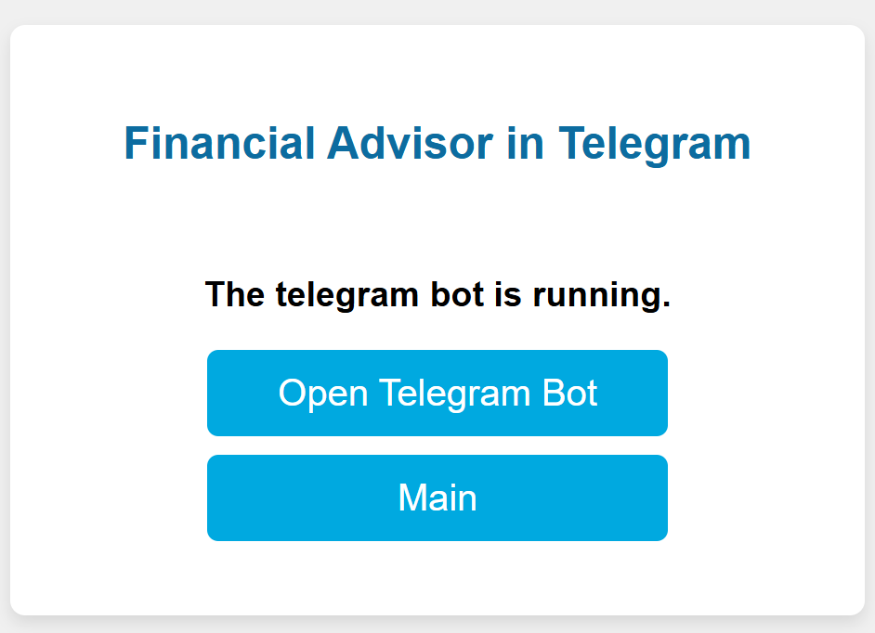
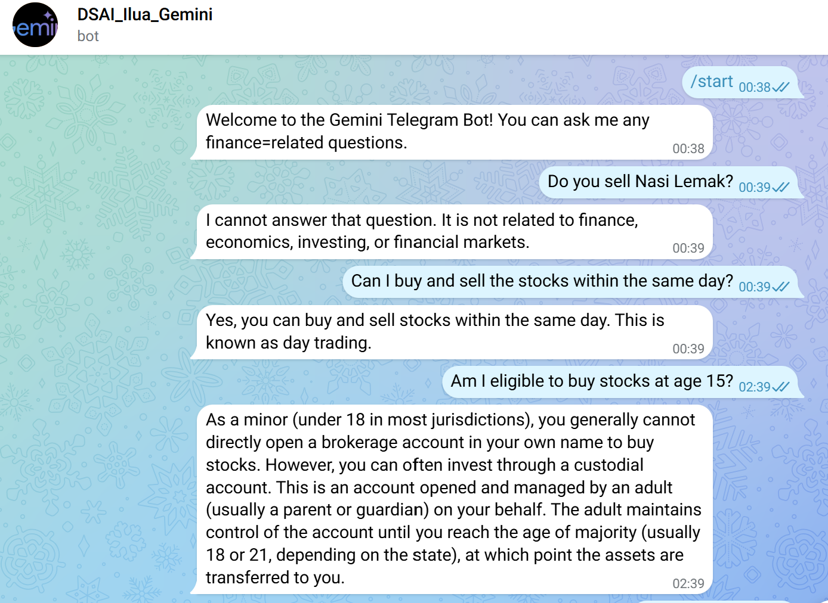
Telegram

